Slide 1
MINIMAL Expense TRACKER
Team - #One
Professor: Pradeep Budharaju TA: Subhalesh Polavarapu

Slide 2
AGENDA
Introduction
Application Scope
Design
MVC Design
Database Design
Mockups and UI
Frameworks
Team
Task Division
Future Scope
Timeline
Summary

Slide 3
INTRODUCTION
"Minimal" is a mobile application for iOS that empowers users to take control of their expenses. With a user-friendly interface and a comprehensive set of tools.
The app aims to make expense tracking simple, innovative and efficient.

Slide 4
APPLICATION SCOPE
Our iOS expense tracking app will provide users with a comprehensive set of features to manage their personal finances effectively.
Key features include expense tracking with customizable categories, budget management, expense analytics, bill reminders.
Users will have the ability to manually enter expenses, capture receipt photos, set budgets, receive notifications.

Slide 5
KEY FEATURES
Expense Tracking
Budget Management
Expense Analysis
Bill Reminders

Slide 6
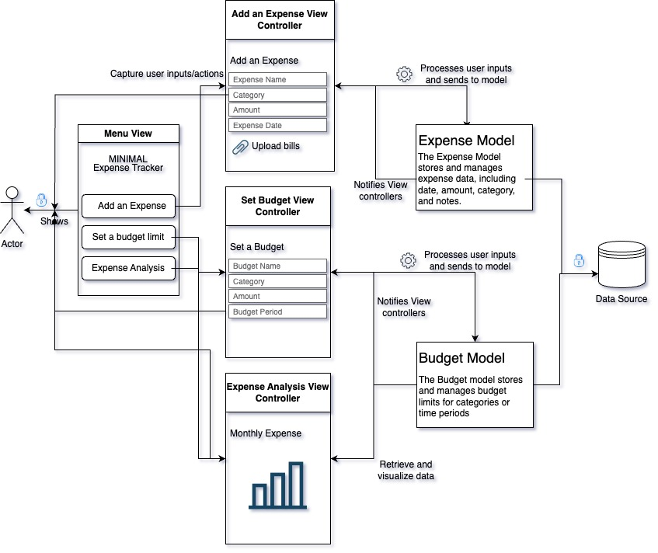
MVC DESIGN

Slide 7
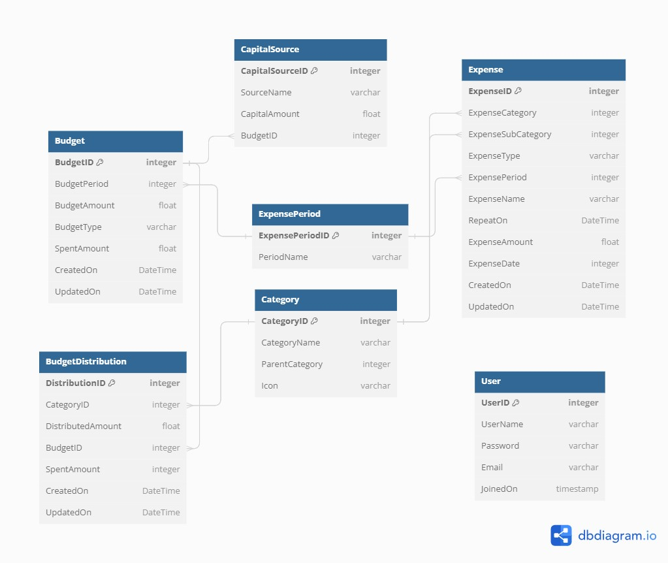
Database design

Slide 8
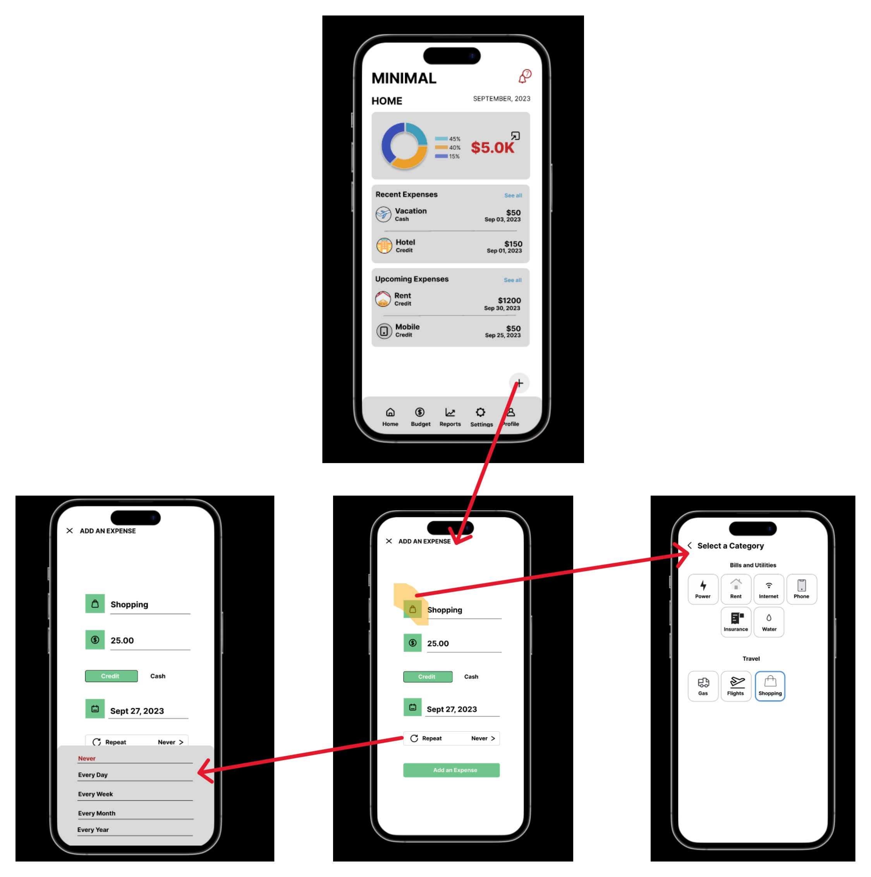
Home screen Mockups

Slide 9
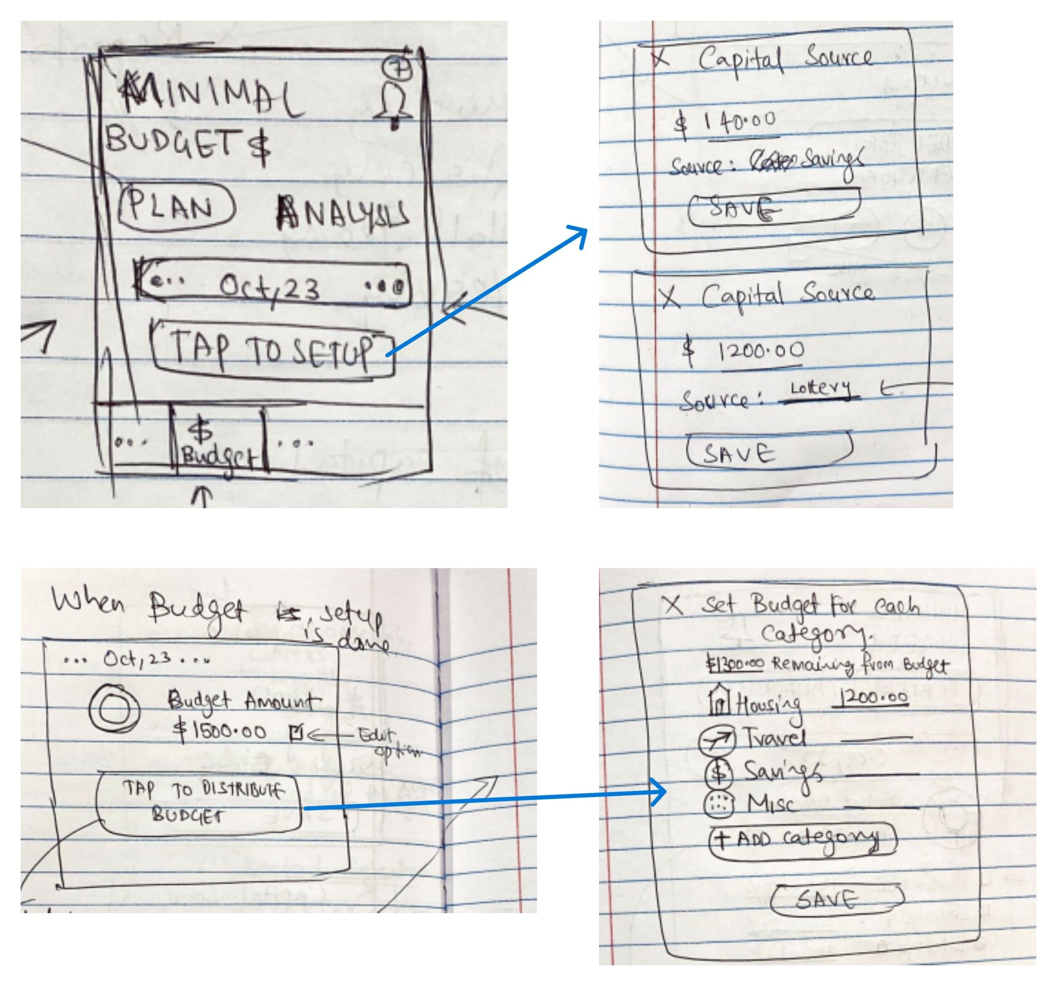
Budget screen Mockups

Slide 10
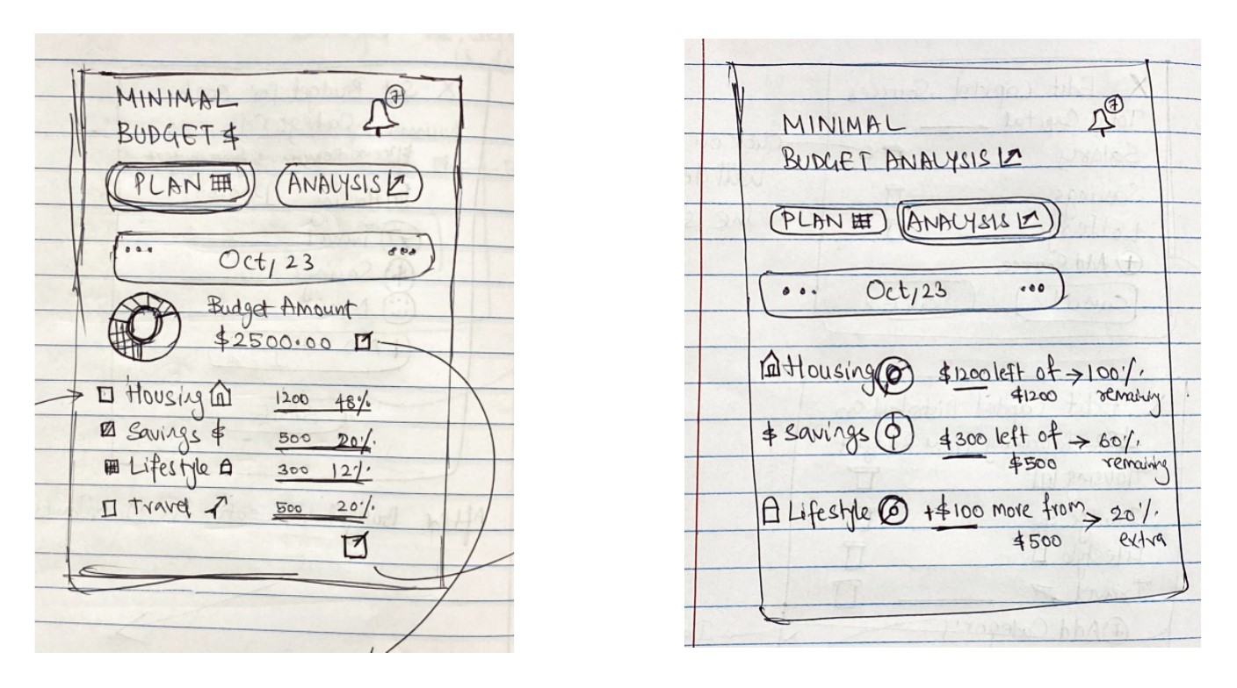
Budget screen Mockups cont…

Slide 11
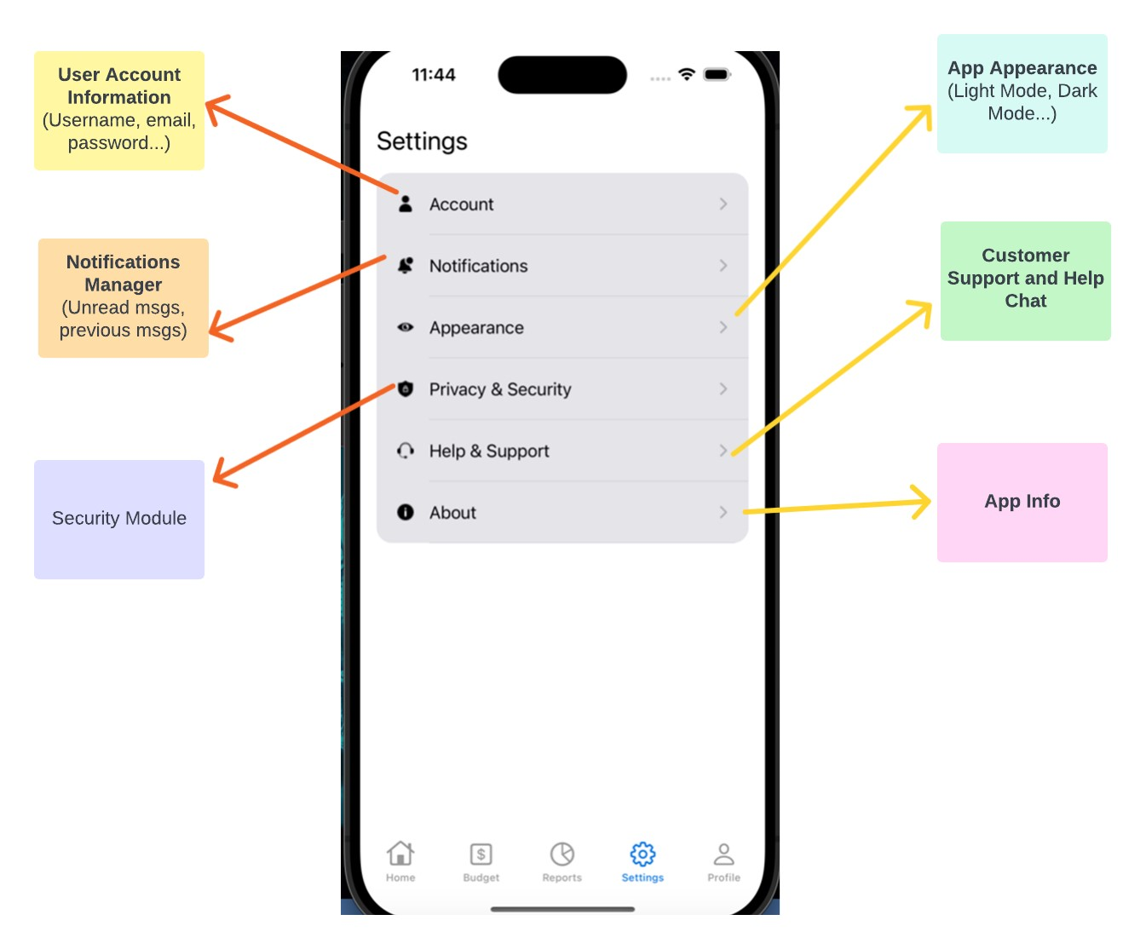
Settings modules

Slide 12
FRAMEWORKS
UIKit
Storyboard
Core Data
User Notifications
Charts - charting framework for Swift and iOS used for creating charts for the expenses to provide detail analysis of their spending to the user (ex: Pie Chart, Bar or Line etc.)
Cocoa Pods – Dependency Management
Swift Packet Manager
Some additional packages might be useful for future scope
Alamofire
Firebase Authentication or OAuth
Keychain Services
XCTest
Crashlytics

Slide 13
"None of us is as smart as all of us." — Ken Blanchard
Ken Blanchard

Slide 14

MEET OUR TEAM
Shivaraj Akula
Sai Vamsi Gorrela
Tahoor Mohammed
Gopi Krishna J
Developer & Manager
Developer
Developer
Developer

Slide 15

TASK DIVISION
Shivaraj Akula
Sai Vamsi Gorrela
Tahoor Mohammed
Gopi Krishna J
App Screens Mockups/Design
Home Screen Modules
Report Binding and Reports UI
Project Documentation
User Profile Module
Settings Module
Testing of App Automations and Test cases
Project Documentation
Database Design
App Screens Mockups/Design
Budget Module and Report Generation
Project Documentation
Home Screen Modules
Chart APIs and Reports UI
Settings Modules
Project Documentation

Slide 16
FUTURE SCOPE
INCOME TRACKING
MULTICURRENCY SUPPORT
CLOUD SYNC
BACKING
USER AUTHENTICATION

Slide 17
TIMELINE
09/14
Project Design Presentation
10/05
Initial draft push to main branch
11/02
Project Mid Review and Presentation and push to main branch
12/07
Final production Review and Presentation

Slide 18
SUMMARY
Our iOS Expense Tracker app offers a comprehensive solution for effective personal finance management. Users can effortlessly track expenses, customize categories, set budgets, and receive bill reminders.

Slide 19
THANK YOU
Shivaraj Akula – akulas2222@uhcl.edu Sai Vamsi – gorrelaS2532@uhcl.edu Tahoor - mohammedT6473@uhcl.edu Gopi – javvajiG8191@uhcl.edu

